Slide 1
Knowledge as a Teacher:
Knowledge-Guided Structural Attention Networks (K-SAN)

Slide 2
NUL简介：
1.Natural language understanding (NLU) is a core component of a spoken dialogue system.
2.A typical pipeline of NLU includes: domain classification, int-ent determination, and slot filling

Slide 3
NUL简介：
3.1:NLU first decides the domain of user’s request given the input utterance
3.2:based on the domain, predicts the intent
3.3:fills associated slots corresponding to a domain-specific semantic template.

Slide 4
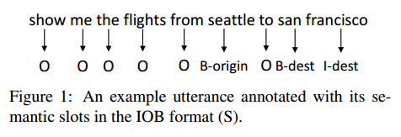
传统的NLU任务：
1.domain detection and intent prediction:support vector machines and maximum entropy
2.slot filling:hidden Markov models (HMM:马尔可夫模型) or conditional random fields(CRF:条件随机场):,slot filling is framed as a word sequence tagging task
问题:信息不足或者缺失的时候效果不好

Slide 5
新模型：
Knowledge-Guided Structural Attention Networks (K-SAN)
创新点：
1.运用语法分析结构生成attention,用于knowledge-guided
2.结合Chain-Based RNN Tagger，Knowledge-Guided RNN Tagger两个模型，做成一个复合的模型

Slide 6
模型简介：
模型有两大阶段
1.Encoded Knowledge Representation
2.slot tagging sequence

Slide 7
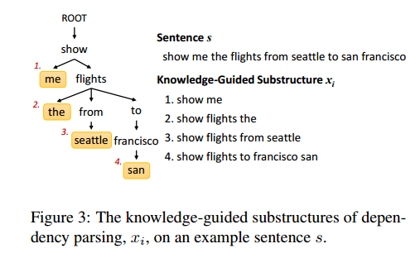

第一阶段：
Encoded Knowledge Representation（To store
the knowledge-guided structure
）
1.Mkg:enconding xi(structure),转变为 d维的向量
2.Min: 将utterance s转变为相同维度的向量

Slide 8
第一阶段：
1）Encoded Knowledge Representation（To store the knowledge-guided structure）
1. fully-connected neural networks (NN) with a inear activation
2. recurrent neural networks (RNN)
3.convolutional neural networks (CNN) with a window size 3 and a max-pooling operation.

Slide 9

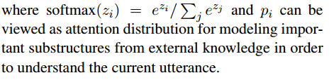
第一阶段：
2）Knowledge Attention Distribution

Slide 10


第一阶段：
3）Sentence Representation
which indicates that the sentence pays different attention to different substructures guided from external knowledge.
h :substructure vector
u:the current input embedding
where we employ a fully-connected dense network
for Mout.

Slide 11

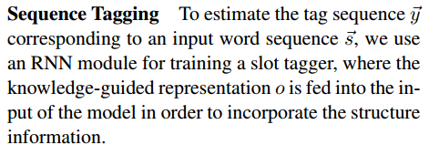
第一阶段：
4）Sequence Tagging

Slide 12
第二阶段：
Recurrent Neural Network Tagger
1 Chain-Based RNN Tagger
2.Knowledge-Guided RNN Tagger
3 Joint RNN Tagger

Slide 13

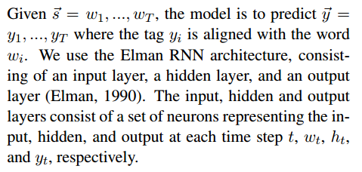
第二阶段：
1 Chain-Based RNN Tagger

Slide 14
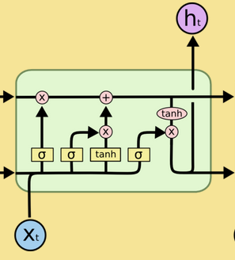
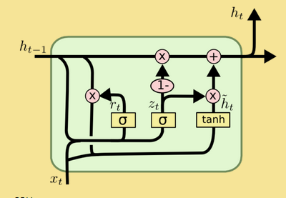
第二阶段：
问题:RNN不能记住间距太长序列之间的关系
LSTM
GRU

Slide 15


第二阶段：
where is an element-wise multiplication.
A GRU has two gates, a reset gate r, and an update gate z .
1.The reset gate determines the combination between the new input and the previous memory
2.the update gate decides how much the unit updates its activation, or content

Slide 16


第二阶段：
2.Knowledge-Guided RNN Tagger
Mo:konwledge-guided
In order to model the encoded knowledge from previous turns, for each time step t, the knowledgeguided sentence representation o in (5) is fed into the RNN model together with the word wt.

Slide 17
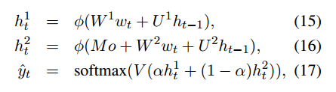
第二阶段：
3 Joint RNN Tagger
In the experiments, α is set to 0.5 for balancing two sides.
Because the chain-based tagger and the knowledgeguided tagger carry different information, the joint RNN tagger is proposed to balance the information between two model architectures.

Slide 18
实验：
1.dataset: ATIS corpus
1.1:Small is 1/40 of the original set
1.2:Medium is 1/10 of the original set 1.3:Large is the full set.
2.evaluation metrics: F-measure
3.parser:Stanford dependency parser
4.loss function:cross-entropy
5.optimizer:adam
6.word embeddings :100 sizes
7.hidden layers{50; 100; 150}
8.dropout rates are set as f0:25; 0:50g
9.tagger:joint RNN tagger

Slide 19
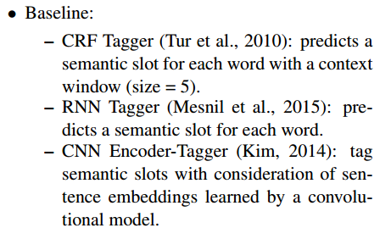
实验：

Slide 20
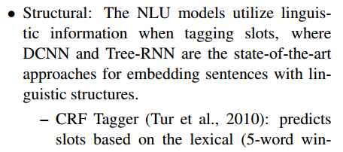
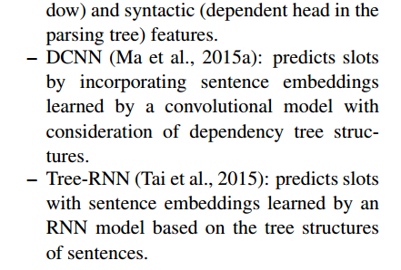
实验：

Slide 21
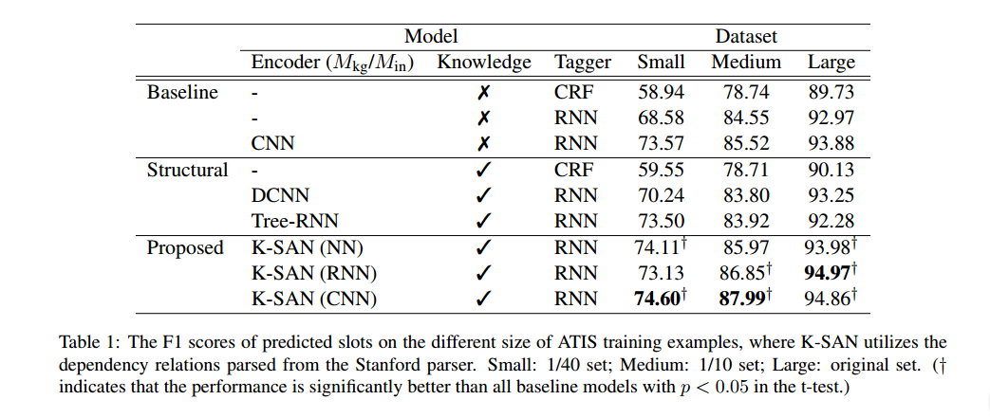
实验：

Slide 22
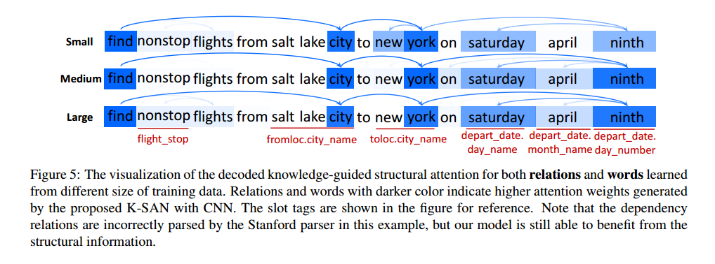
实验：

Slide 23
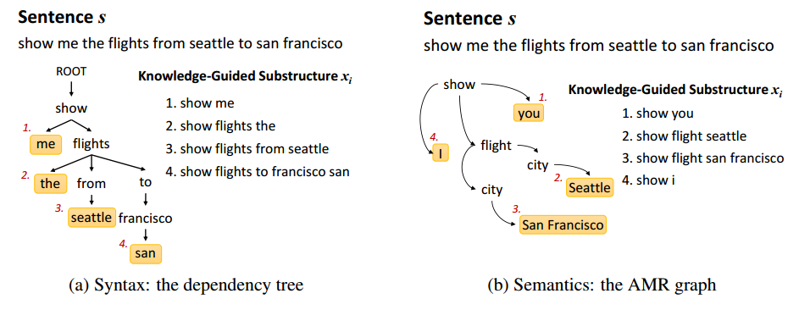
实验：
AMR is a semantic formalism in which the
meaning of a sentence is encoded as a rooted, directed, acyclic graph (Banarescu et al., 2013), where
nodes represent concepts, and labeled directed edges
represent the relations between two concepts.

Slide 24
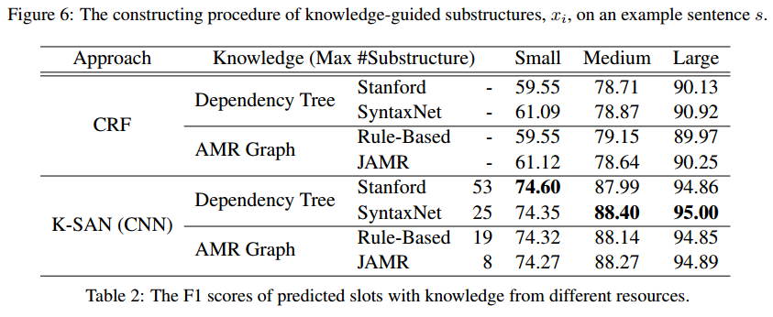
实验：

Slide 25
谢谢观看，再见！

